Slide 1
ADVANCED PROGRAMMING-ITIC 2223
Lecture 05- Conditional Statements
Ramesh Madhuranga
MPhil.(Reading) (USJP), BICT (Hons) (RUSL), AMCSSL
Department of Biosystems Technology
Faculty of Technology
Kotelawala Defence University

Slide 2
What is a Conditional Statement?
You can control the flow of a program by providing condition(s) to the code.
In this lesson we mainly discuss two conditional statement types.
IF/ELSE statements
IF/ELIF/ELSE statements

Slide 3
IF/ELSE Statements
How if/else statement works
If the condition is true the statements inside the body of if are executed.
Ex :-when the condition (a>b) is true
Python syntax
Python uses indentation as its method of grouping statements
a = 200
b = 100
if a >b :
print("a is greater than b") else :
print("a is less than b")
if condition :
Statements
else
Statements
indentation
Output : a is greater than b

Slide 4
IF/ELSE Statements
If the condition is false, only the statements in the else block will be executed.
Ex:- when the condition(a>b) is false
Python syntax
a = 200
b = 300
if condition :
Statements
else:
Statements
if a >b :
print ("a is greater than b") else :
print ("a is less than b")
Output : a is less than b

Slide 5
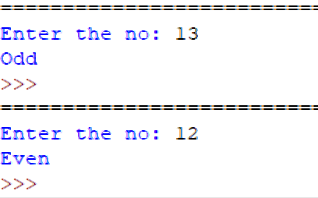
Conditional Statements -Example
If a given number is even, print “even” else print “odd”.
:
number = int(input("Enter the no: ")) If(number%2)==1:
print("Odd")
else:
print("Even")

Slide 6
IF/ELIF/ELSE Statements
When more than one condition to test, the program will execute only the block of statements under the satisfying condition(the condition evaluated to true).
Other parts of the code will be ignored.
Ex: when the a==b expression is true
Syntax :
a = 100
b = 100
if condition1:
Statements elif condition 2:
Statements elif condition 3:
Statements
else:
Statements
if a >b :
print("a is greater than b") elif a==b:
print ("a and b have same the value")
else:
print("a is less than b")
Output :a and b have the same value

Slide 7
IF/ELIF/ELSE Statements
If all conditions are false, only the statement(s) inside the else block will be executed.
a = 50
b =100
if a >b :
print("a is greater than b")
elif a==b:
Print ("a and b have same the value")
else:
print("a is less than b")
Output : a is less than b

Slide 8
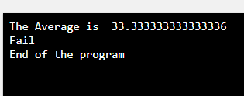
Conditional Statements -Example
Student marks are input to a program as using variables m1,m2 and m3. Write a program to calculate the average and display the grade and the average.
m1=80 m2=10 m3=10
avg=(m1+m2+m3)/3
print ("The Average is ", avg) if avg>=75:
print("Result is A")
elif avg >=60:
print("Result is B") elif avg >=40:
print("Result is C")
else:
print("Fail")
print("End of the program" )
Output:

Slide 9
Conditional Statements – Exercises
Add 5 numbers. If the total is greater than 50 print “pass” else print “fail”.
If the given marks are greater than 60 print “well done” else print “repeat”.
Get the average of 10 numbers. If the average is greater than 20, print “greater” else print “less”.

Slide 10
Any Questions?
HAVE A NICE DAY!

